Slide 1
Hack Hurricane 1.0
Air India Airlines website project

Slide 2
Objectives -
Simple website of Air India Airlines
To serve the interactive UI of the website.
To make clean and easy UI.
Easy to explore the flights and easy to book tickets.
Easy to login and signup.
Entertainment feature on the website.
Map feature of the different countries.

Slide 3



Technologies used -
HTML – Used to design the basic structure of the page.
CSS – Used to style the web page more interactive
JavaScript – Used to make the website the dynamic.
Node js – Used to create the runtime environment for JavaScript.
MongoDB – Used for the backend.

Slide 4
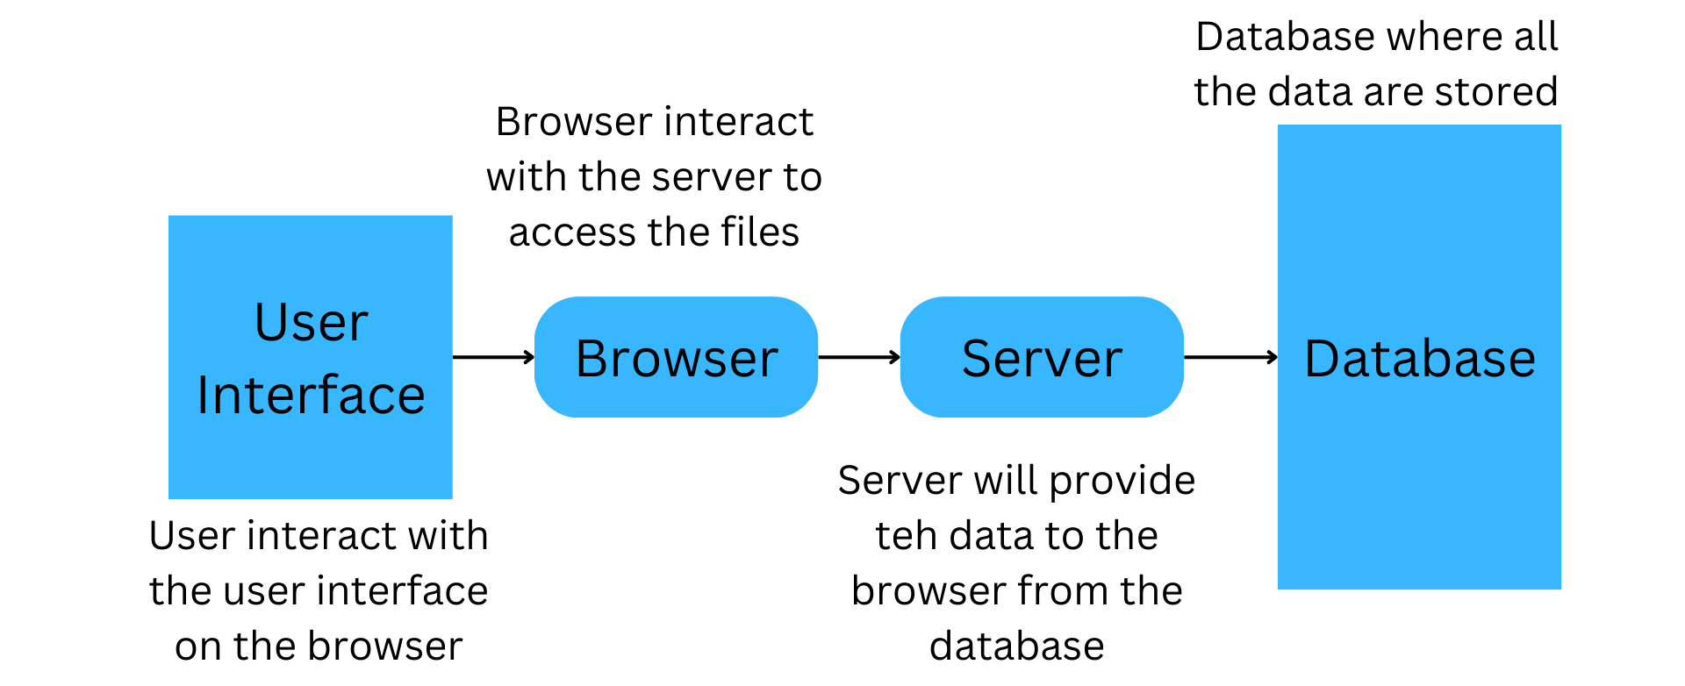
Flow diagram -

Slide 5
Challenges -
Initially difficulties to find the problem.
In starting the development of the development.
Difficulties to design the user interface.
Difficulties in creating connection with backend.
Collection of raw material.

Slide 6
Future scope -
Provide the booking facility
Providing the tracking system
Maintaining the booking history
Payment gateway integration
Flight schedules
Daily updates
Upcoming journey notification
Payment wallet system

Slide 7


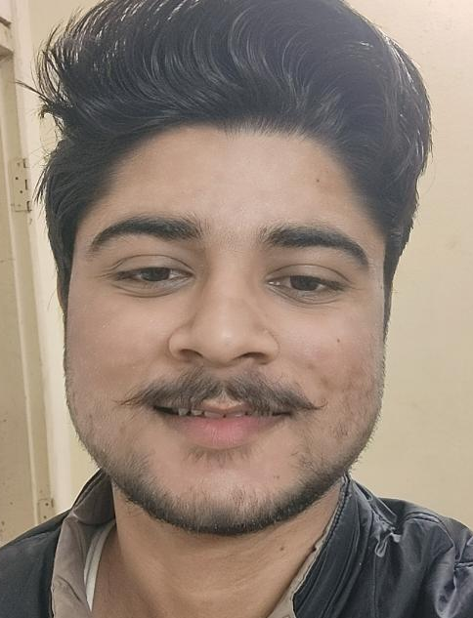
Team mates (DevJoint)-
Himanshu
Gufran Alam
Sourav Tyagi

Slide 8
Himanshu Web developer Worked on the frontend of the website. Gufran Alam Web developer Work on the backend and as well as the frontend of the website. Sourav Tyagi Web developer Worked on the frontend of the website.

